Slide 1
Android Mobile Programming
October 2012
Tom Karni, Itsik Avidan

Slide 2
Course Assignments
Class assignments :
Mandatory 8 class assignments
Assignment that will not be submitted will reduce 2 point.
Android Lectures (15%) :
Each group will select an available topic and will prepare a 15 min presentation.
Final project (85%):
Create an Android application.

Slide 3
On The web
Course website - http://moodle2.bgu.ac.il/course/view.php?id=370
Course forum @ Facebook
https://www.facebook.com/groups/cse.mobile.programming/

Slide 4
Mobile Programing Into

Slide 5
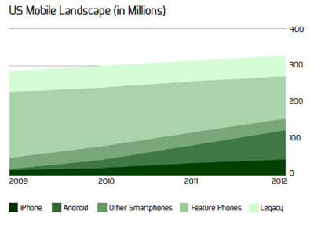
Smartphones market share
Smartphones market share 2012
Rapid increase in the number of smartphones on the network
At the end of 2012 estimated 47% in the US

Slide 6
Smartphones market share
Android Market Share Q3 2012
Currently the Google’s Android Mobile OS is the #1 platform

Slide 7







Native vs. HTML5
When considering to develop a mobile application, the developer should consider his alternatives
Native programming ( Java, Objective C )
Web based programming ( HTML5, JavaScript)

Slide 8
Considerations
Can we build a reach features application ?
Access to device’s hardware
Integration with other Apps and devices
3D graphics
Will it preform ?
GPU acceleration
Multi threading
JS is the latest and greatest
WebGL is available
Notes:
http://www.youtube.com/watch?v=JuFqUspiR8g

Slide 9
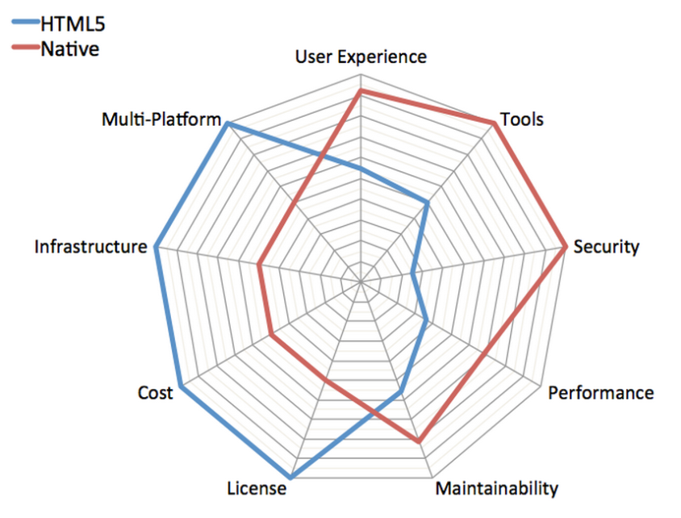
Considerations
Developer Tools ?
Objective C / JAVA
HTML5 / JS / CSS
End user experience ?
Use the OS widgets
Create your own theme
It is the economy !
Apple’s App-Store / Google’s Play
Open to every mobile browser

Slide 10
Java Design Patterns

Slide 11
Intro
Design patterns capture the experience of expert software developers and present common recurring problems, their solutions, and the consequences of those solutions in methodical way
Patterns - Abstracting solutions to recurring design problems
Design patterns help overcome the problem of too many objects with too many interactions and therefore dependencies, creating a monolithic system that is hard to maintain and impossible to reuse.
Flexible and reusable software.

Slide 12
Java Design Parterres
Composite
Member Class
Inner Class
Anonymous Class
Singleton
M.V.C

Slide 13
Composite
The composite pattern purpose is to enable to treat a group of objects as a single instance of that object.
Composite should be used when you are using multiple object in the same way and have nearly identical code to handle each of them.

Slide 14
Member Class
Declared as a non-static member of a containing class.
Has access to all the instance fields and instance methods (as well as the static members) of the containing class, including any that are declared private.
Cannot contain any static fields, methods, or classes (with the exception of constant fields declared both static and final). [static fields, methods, and classes are top-level constructs not associated with any particular object, while every member class is associated with an instance of its enclosing class.]

Slide 15
Local Class
A local class is declared locally within a block.
Valid only within the scope defined by its enclosing block.
Cannot be declared public, protected, private, or static.
Like member classes, and for the same reasons, local classes cannot contain static fields, methods, or classes. The only exception is for constants that are declared both static and final.

Slide 16
Anonymous Class
Is a local class without a name.
The definition is an expression, which means that it can be included as part of a larger expression, such as a method call.
Useful when a local class is used only once.
Share the same restrictions as a local class.

Slide 17
Singleton
The singleton pattern purpose is maintain a single instance of an Object.
This is needed when exactly one instance of the Object is needed / allowed in the program and duplication of it may cause data conflicts.
There are many ways to implement a Singleton, each one has it Cons & Pros regarding to memory and threads management

Slide 18
Model –View - Controller
MVC separation helps you manage complex applications, by using it, the developer can focus on one aspect a time
Model – Handles the logic for the application data.
View – handles the display of the data.
Controller – handles user interaction.
Disclaimer - On Android, the MVC architecture is partly implemented due to project structure, View & Controller are implemented jointly.
M
updates
modify
V
C
modify
sees
User
uses

Slide 19


References
O'Reilly [http://docstore.mik.ua/orelly/java-ent/jnut/ch03_09.htm]
Oracle “The Java Tutorial [http://docs.oracle.com/javase/tutorial/java/javaOO/nested.html]
Gallard, D., “Java design patterns 101” [http://www.ibm.com/developerworks/java/tutorials/j-patterns/resources.html]

